Slide 1



Context for low-level saliency detection
Devi Parikh, Larry Zitnick and Tsuhan Chen

Slide 2
For what can context be used?
So far higher level tasks
What about lower level tasks?
Picking out salient (representative) patches in an image?

Slide 3
Set up
Bag-of-words paradigm
?
SVM
Sample image
Build histogram
Sample image
Classify

Slide 4
Saliency
Interest point detectors
[Lowe 2004, Harris 1988, Kadir-Brady 2001, etc.]
Uniform
Discriminative
[Nowak et al., ECCV 06, Vidal-Naquet et al., ICCV 2003]
Contextual
Co-occurrence based
Relative location based

Slide 5
Contextual saliency
Occurrence based
Association of patch i to word a
Association of patch j to word b
Likelihood of word b given word a
Normal distribution
Normal distribution
MLE from images
Similarly, relative location based

Slide 6
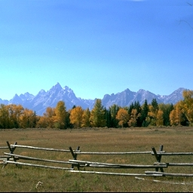
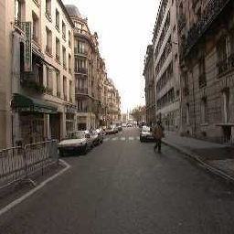

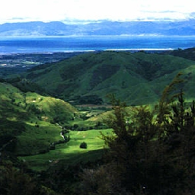
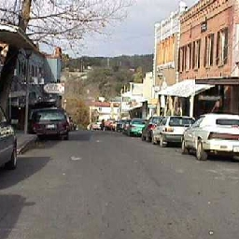


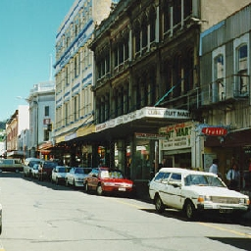
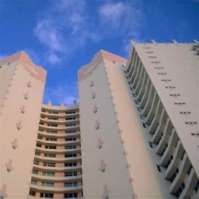
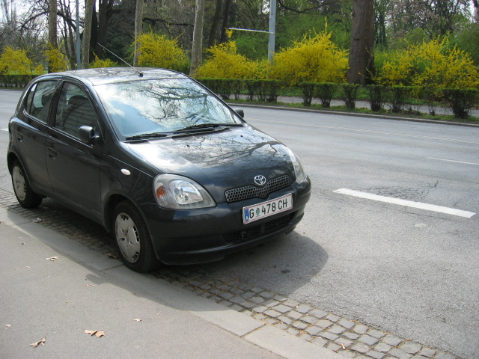


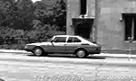
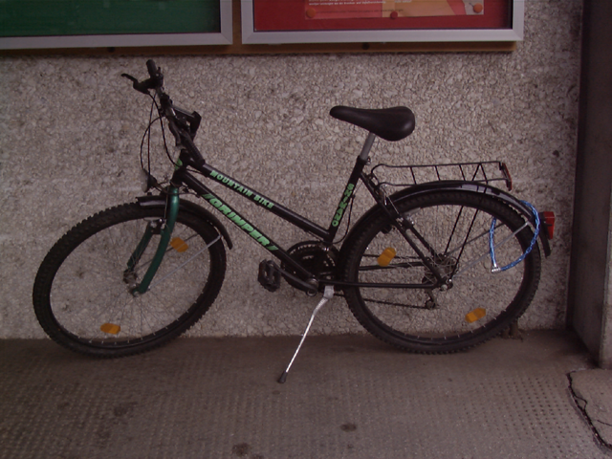

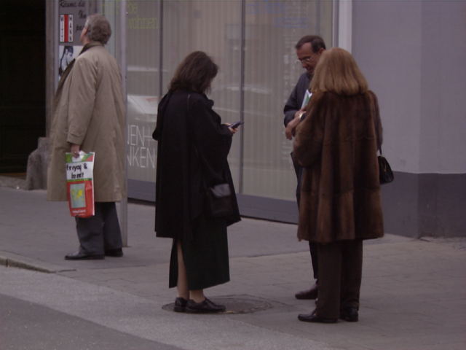
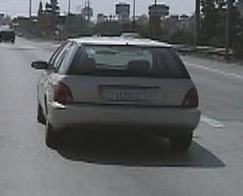

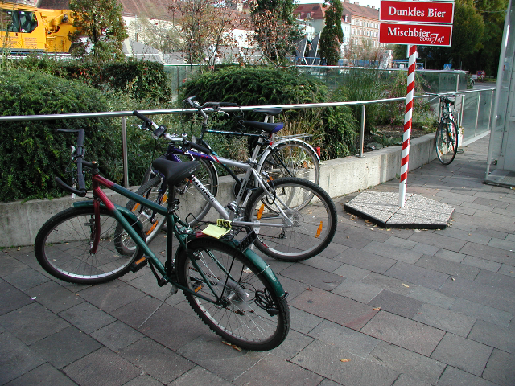

Datasets
coast forest highway inside-city mountain open-country street tall-building
[Oliva Torralba IJCV 2001]
cars bicycles motorbikes people
Pascal-01

Slide 7
Features
Scene recognition
Color information
Some gradient information inherent
Object recognition
SIFT

Slide 8
Results

Slide 9
Results

Slide 10
Saliency maps

Slide 11
Saliency maps

Slide 12
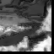
Sampling strategies
Sorting
Random sampling
Sequential sampling

Slide 13
Sequential sampling

Slide 14

Sequential sampling

Slide 15
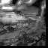
Sequential sampling

Slide 16
Results

Slide 17
Contributions
Context can be leveraged for low-level tasks
Outperform several existing saliency measures
Sparse representation was found to be more accurate

Slide 18
Discussion
Discrminative vs. contextual saliency
Saliency is a subjective term: task and domain dependent
Representative (usual)
Interesting (unusual)
Generic defintion: Informative
Contextual saliency is unsupervised but is dataset dependent

